Slide 1
Hands-on with Visualforce in Lightning
Bite-size app integrations
Alexander Dale and Mike Senn

Slide 2


Alexander Dale
Visualforce Platform Developer
Mike Senn
Visualforce Platform Developer
alexander.dale@salesforce.com
msenn@salesforce.com

Slide 3
Forward-Looking Statements
Statement under the Private Securities Litigation Reform Act of 1995: This presentation may contain forward-looking statements that involve risks, uncertainties, and assumptions. If any such uncertainties materialize or if any of the assumptions proves incorrect, the results of salesforce.com, inc. could differ materially from the results expressed or implied by the forward looking statements we make. All statements other than statements of historical fact could be deemed forward-looking, including any projections of product or service availability, subscriber growth, earnings, revenues, or other financial items and any statements regarding strategies or plans of management for future operations, statements of belief, any statements concerning new, planned, or upgraded services or technology developments and customer contracts or use of our services.
The risks and uncertainties referred to above include – but are not limited to – risks associated with developing and delivering new functionality for our service, new products and services, our new business model, our past operating losses, possible fluctuations in our operating results and rate of growth, interruptions or delays in our Web hosting, breach of our security measures, the outcome of any litigation, risks associated with completed and any possible mergers and acquisitions, the immature market in which we operate, our relatively limited operating history, our ability to expand, retain, and motivate our employees and manage our growth, new releases of our service and successful customer deployment, our limited history reselling non-salesforce.com products, and utilization and selling to larger enterprise customers. Further information on potential factors that could affect the financial results of salesforce.com, inc. is included in our annual report on Form 10-K for the most recent fiscal year and in our quarterly report on Form 10-Q for the most recent fiscal quarter. These documents and others containing important disclosures are available on the SEC Filings section of the Investor Information section of our Website.
Any unreleased services or features referenced in this or other presentations, press releases or public statements are not currently
available and may not be delivered on time or at all. Customers who purchase our services should make the purchase decisions
based upon features that are currently available. Salesforce.com, inc. assumes no obligation and does not intend to update
these forward-looking statements.

Slide 4

Agenda
A Hands-On Example of including Visualforce in a Lightning Page layout
Helping you to prioritize your migration story
A Demonstration of handling Lightning Events within Visualforce

Slide 5
Basic Visualforce Integration Demo
Notes:
Thanks Mike, one of the really cool things about Visualforce is how it allows us to easily integrate existing web api’s into our Visualforce pages. We want to show you a nuts and bolts example of this in action.

Slide 6

Twitter Code Snippet
<blockquote class="twitter-tweet">
<a class="twitter-timeline"
href="https://twitter.com/handle"
data-chrome="noheader,nofooter”
data-tweet-limit="1"
height="250">
Tweets by @handle
</a>
</blockquote>
<script async="" src="//platform.twitter.com/widgets.js" html-charset="utf-8" />
Notes:
Our new head of Sales is really interested in driving social media engagement, so I found a code snippet, at dev.twitter.com, that allows us to display the last tweet a person sent. So to help out Sales, let’s see if we can find a way to integrate this code into Lightning.

Slide 7
Game Plan
Create a Twitter Handle custom field for Contact
Take the Twitter code snippet convert it to be used in Visualforce
Expose the Visualforce Page in the Contact standard layout.
Notes:
So now that we solemnly swore we’re up to no good, let’s take a look at the game plan

Slide 8
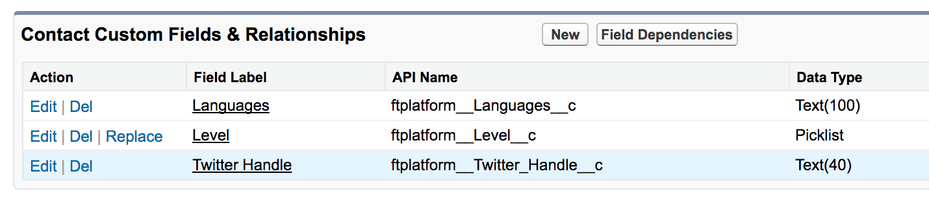
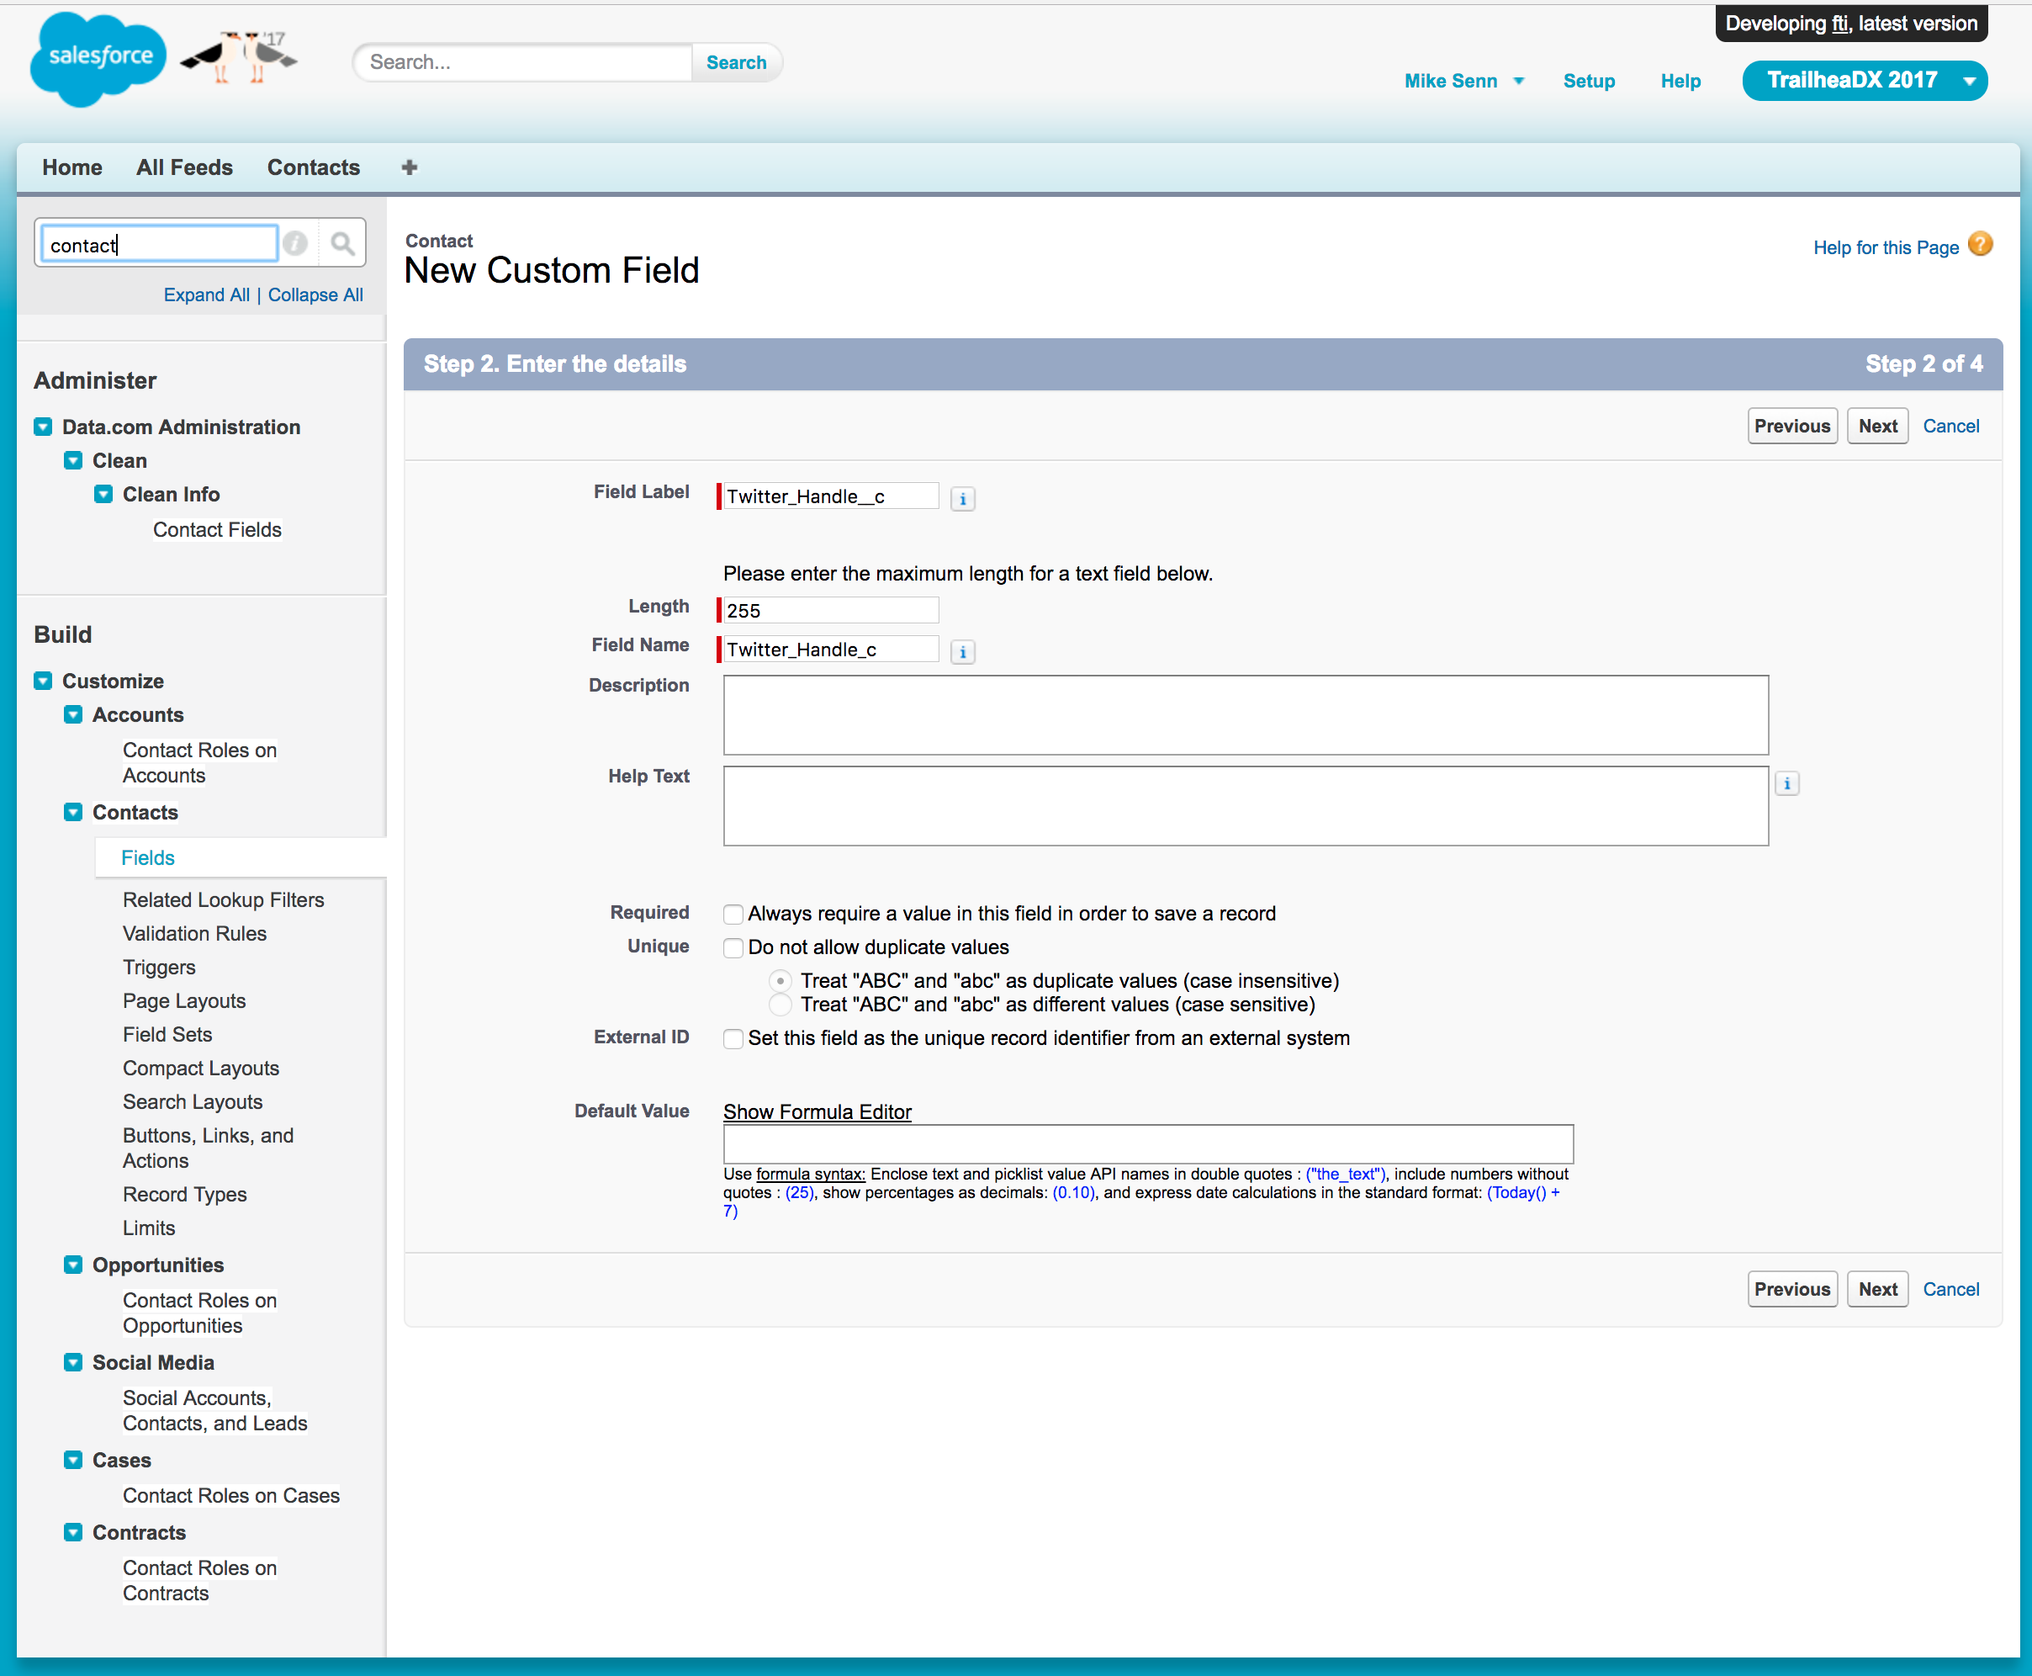

Add a Twitter Handle custom field for Contact
1.
2.
3.
Notes:
We’re just going to briefly cover this, since this technique is well known.

Slide 9
Game Plan
Create a Twitter Handle custom field for Contact
Take the Twitter code snippet convert it to be used in Visualforce
Expose the Visualforce Page in the Contact standard layout.

Slide 10
Demo Time!

Slide 11
Converted to a Visualforce Page
<apex:page standardController="Contact">
<blockquote class="twitter-tweet">
<a class="twitter-timeline"
href="https://twitter.com/{! contact.Twitter_Handle__c}"
data-chrome="noheader,nofooter" data-tweet-limit="1" height="250">
Tweets by @{! contact.Twitter_Handle__c}
</a>
</blockquote>
<script async="" src="//platform.twitter.com/widgets.js" charset="utf-8" />
</apex:page>

Slide 12
Game Plan
Create a Twitter Handle custom field for Contact
Take the twitter code snippet convert it to be used in Visualforce
Expose the Visualforce Page in the Contact standard layout.

Slide 13
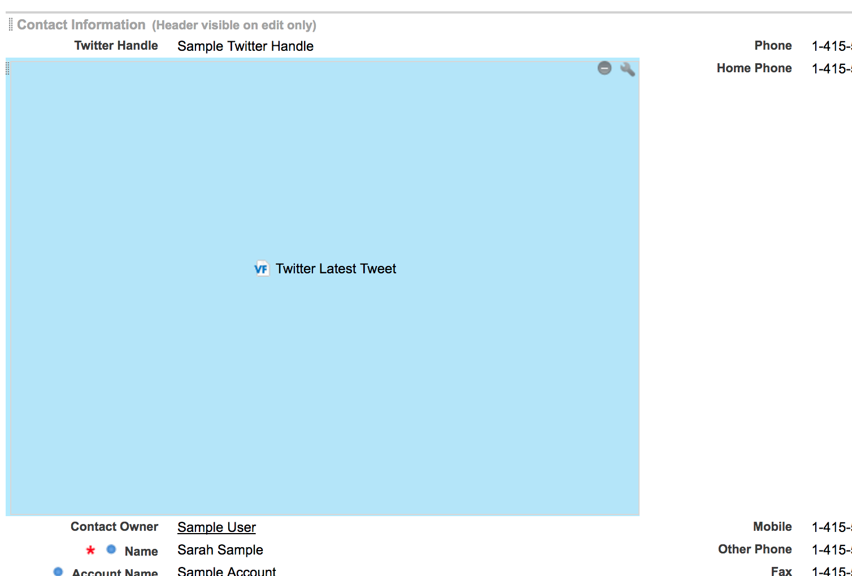
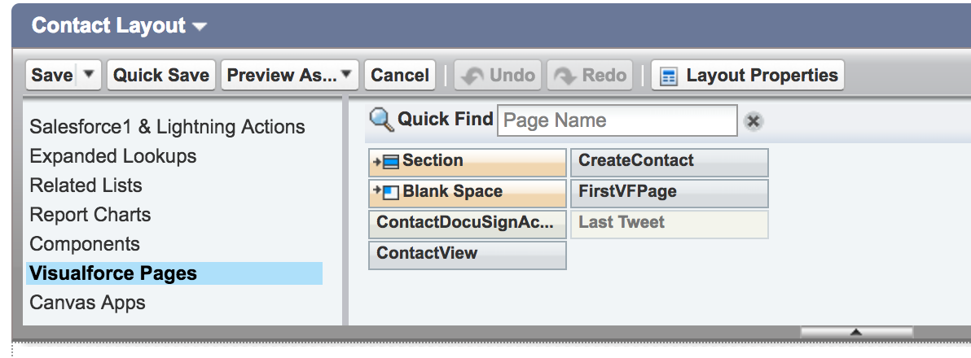
Add Page to the Standard Layout

Slide 14
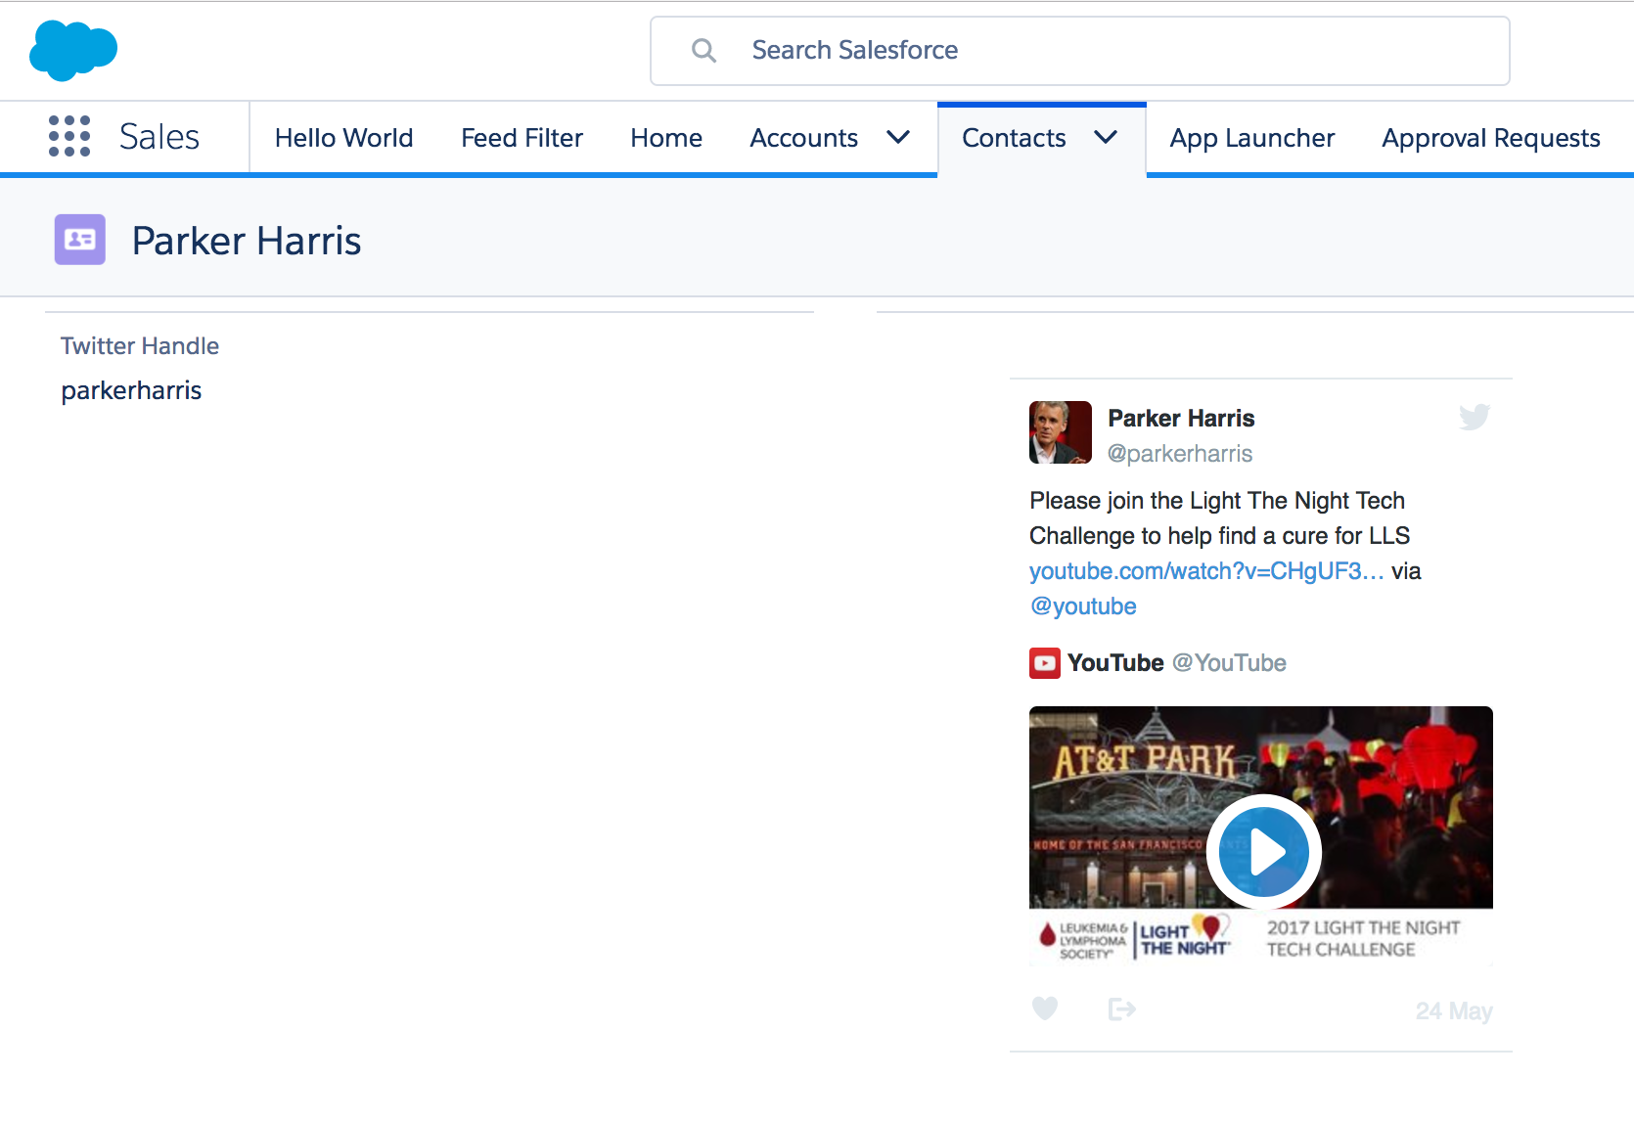


Final Result
Now our tweet appears on the contact page!

Slide 15

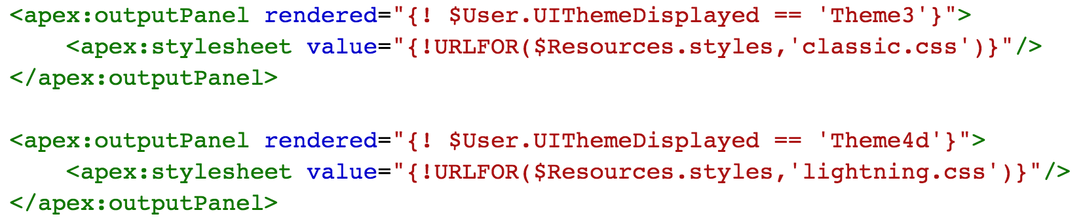
Detecting the Experience
Adapting your page to the user’s experience
Salesforce Classic
Lightning Experience
Salesforce1
$User.UIThemeDisplayed controls the user’s “current UI context”.
In Apex, use equivalent system method UserInfo.getUiThemeDisplayed()
Notes:
Transition:
We’ve just demonstrated how Visualforce pages can be included in Lightning with no modifications. But what if you wanted to have your Visualforce page display differently in lightning than in classic? Use UIThemeDisplayed
Now, your existing Visualforce pages don’t have to look the same way in Classic and Lightning -- You can make them better in Lightning!
You can deliver a better look and feel for you application by customizing your users’ Salesforce experience.
The functionality of the page will remain the same, but you can update the appearance to look like a modern web app.
Here’s something I like to do in my environments: Build one version of the CSS files for Salesforce Classic, and one version for Lightning.
I can use UIThemeDisplayed, and the render attribute of an outputPanel component to include the right version of stylesheets at runtime.
Of course, this is front-end web development. There are many ways to display styles applicable to your user’s environment. Find the right one that works for you.

Slide 16
Planning Your Migration
Notes:
Transition:
Writing a single Visualforce page was a simple task. But you have a more complex task ahead; hundreds of existing Visualforce pages. But when it comes to migrating to lightning, which pages deserve to be the focus of your development effort?

Slide 17
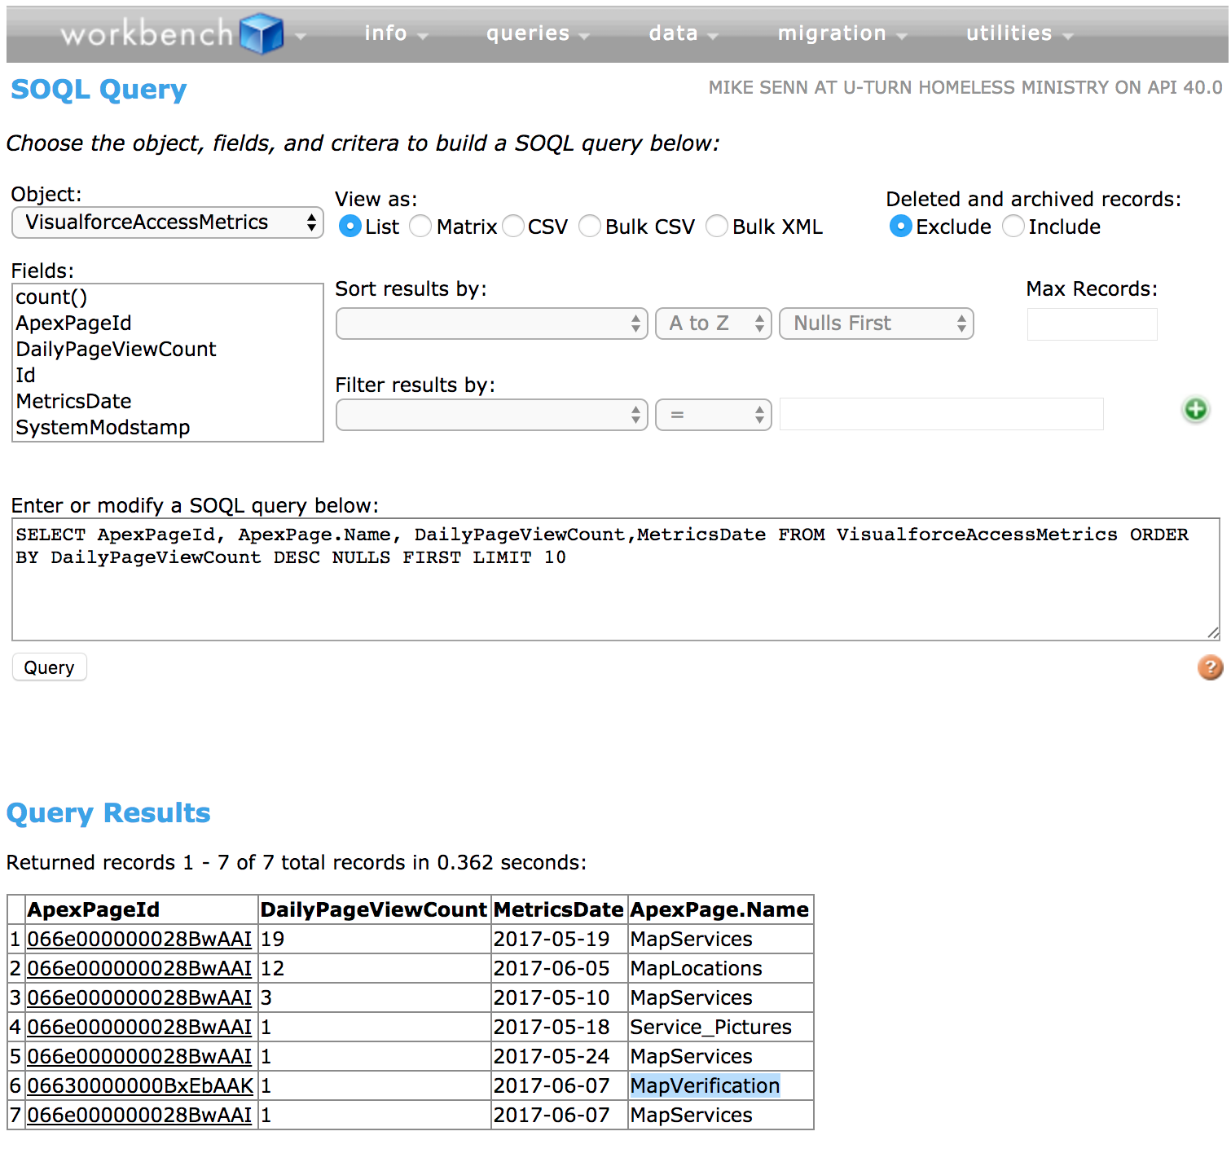

Prioritizing Your Lightning Migration
(Q) Which Visualforce Pages deserve to be the focus of our development effort during the lightning migration?
(A) Use APIs and Workbench to find out which Visualforce pages are accessed the most frequently
Notes:
Transition:
Writing a single Visualforce page was a simple task. But you have a more complex task ahead; hundreds of existing Visualforce pages. Which pages deserve the focus of your development?
What’s worked for some partners is to look at which Visualforce are pages are the most popular. We’ve added a new way to track how often your Visualforce page is viewed. You can query the newly created VisualforceAccessMetrics entity.
Each entity tracks how many visits your Visualforce page has received on a given day. This can be accessed via SOQL queries.
Note: Each VisualforceAccessMetric entity only exists for a period of 90 days.

Slide 18
Example SOQL Queries
SELECT ApexPage.Name, DailyPageViewCount, MetricsDate FROM VisualforceAccessMetrics WHERE CreatedDate = LAST_90_DAYS ORDER BY DailyPageViewCount DESC LIMIT 10
SELECT ApexPage.Name, sum(DailyPageViewCount) FROM VisualforceAccessMetrics GROUP BY ApexPage.Name ORDER BY sum(DailyPageViewCount) DESC LIMIT 10

Slide 19
Advanced Visualforce Integration
Notes:
Next we want to demonstrate how to migrate an existing Visualforce page and add some additional lightning integration along the way.

Slide 20
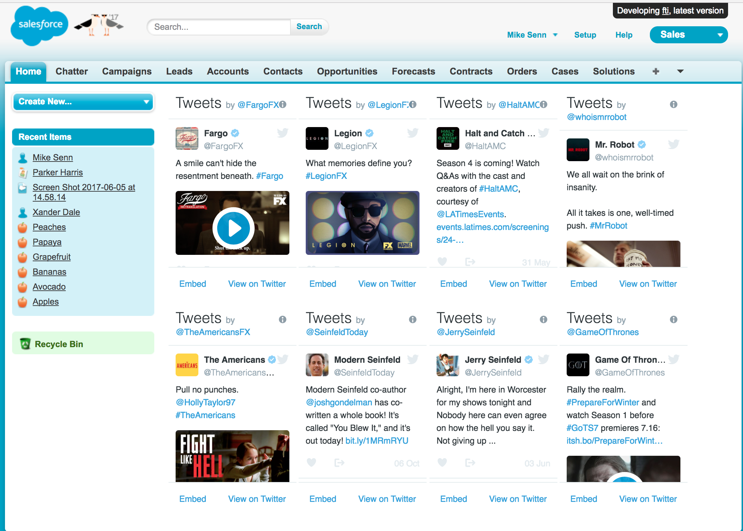


Existing Visualforce Page
Notes:
We took a look at our most popular Visualforce page. Which is a set of twitter timelines representing a contact’s favorite TV shows. More than just migrating this page to lightning we want to add some interaction with lightning components.

Slide 21
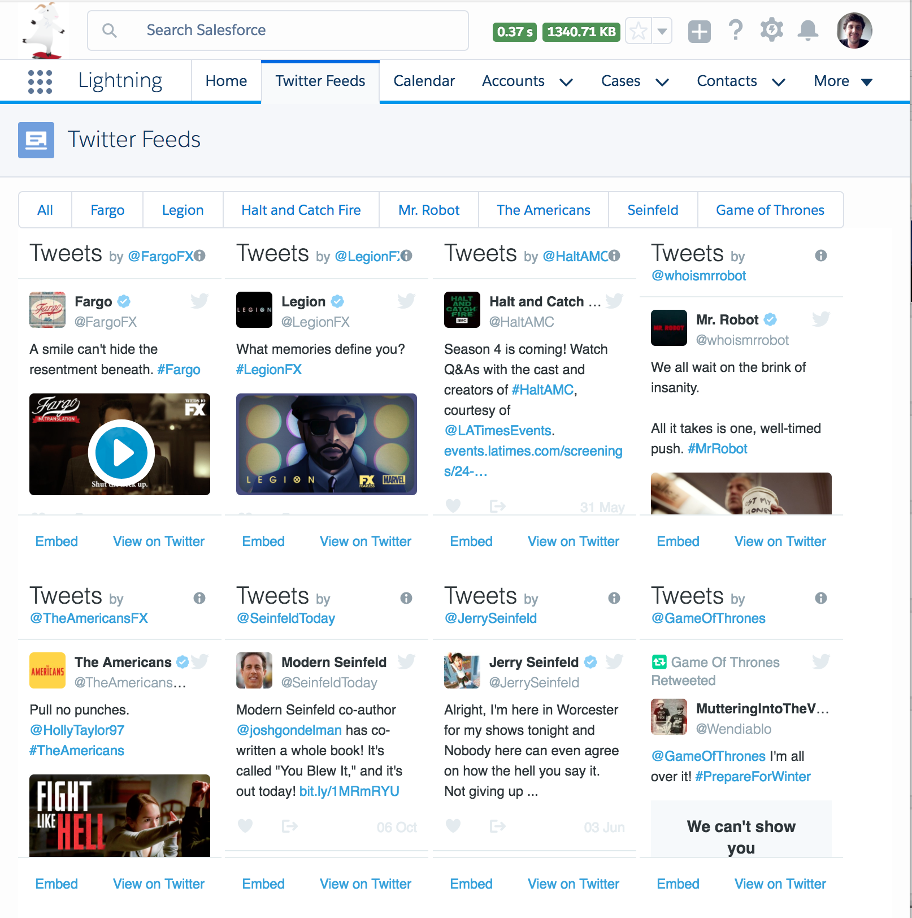
Getting the components together
Lightning component – radio button group
https://www.lightningdesignsystem.com/components/radio-button-group/
Notes:
Looking at lightningDesignSystem.com, we found a really cool radio button group that we can use for navigation. We want to use this bar to filter the list of twitter feeds. This will allow our organization to migrate to Lightning while adding some new functionality. Users will be happy to enable Lightning, because they get more features.

Slide 22
Game Plan
Send Lightning Events to our page
Capture Lightning Events in our page to filter Twitter feeds
Double check that our existing Visualforce page will work great in Lightning
Notes:
Go to Demo from here

Slide 23
Demo Time!

Slide 24
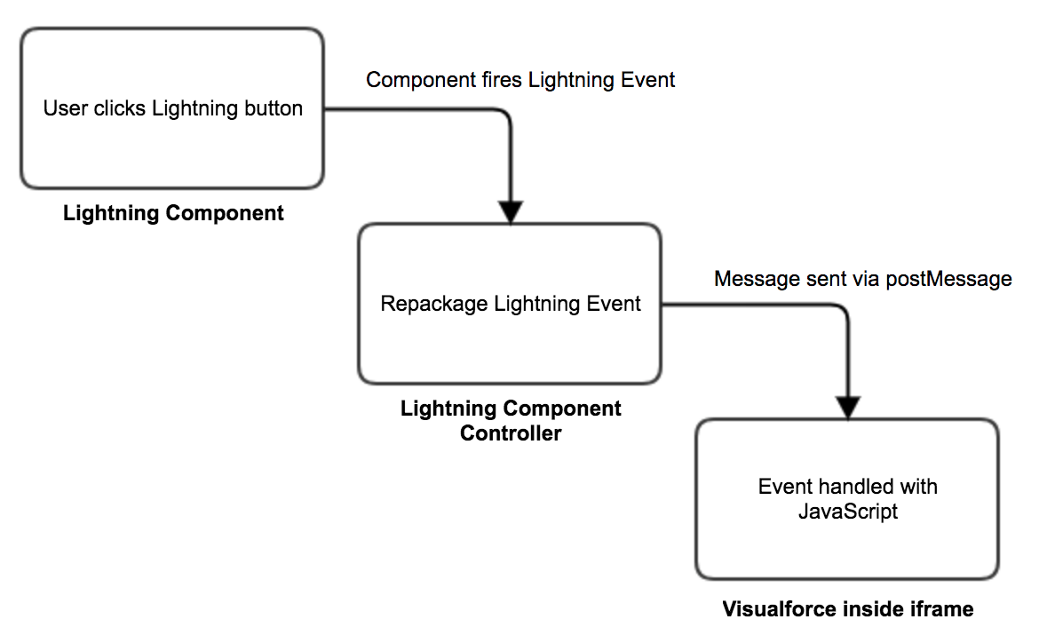




Event Handling Flow from Lightning to VF

Slide 25
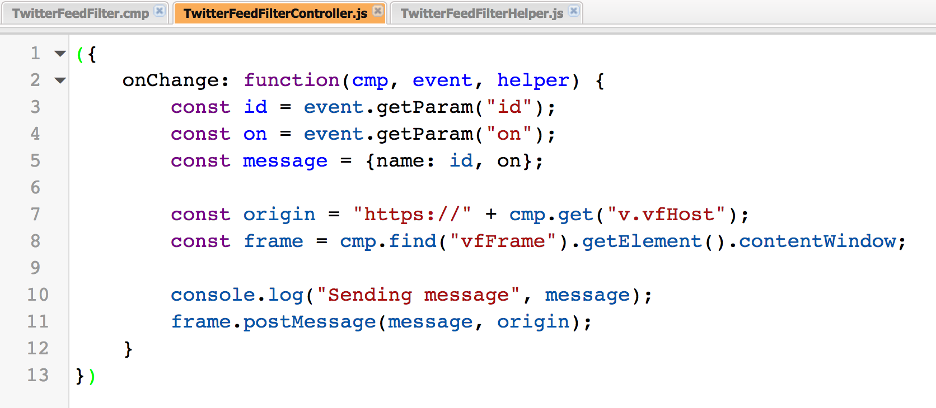
Handling Lightning Events in Visualforce
Repackaging Lightning Events to send to Visualforce

Slide 26
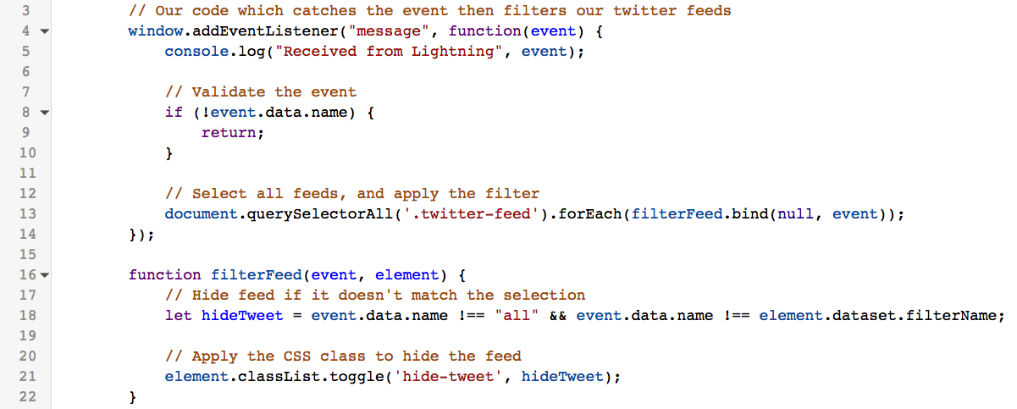
Handling Lightning Events in Visualforce
Receiving the event in Visualforce

Slide 27

Handling Lightning Events in Visualforce
Completed App

Slide 28
Looking back
How to quickly create new Visualforce Pages in Lightning
How to display the right theme for your Visualforce page
Find out how popular your pages are with VisualforceAccessMetrics
How to pass data from Lightning to Visualforce

Slide 29
Further Thoughts…
Session code and these slides - https://github.com/mpsenn/trailheadx2017
Communicating between Lightning Components and Visualforce Pages - Salesforce Developers Blog
Visualforce & Lightning Experience Trailhead Module

Slide 30

https://github.com/mpsenn/trailheadx2017

